Slide 1

Durham Employment Forum
Friday 15th November 2024

Slide 2
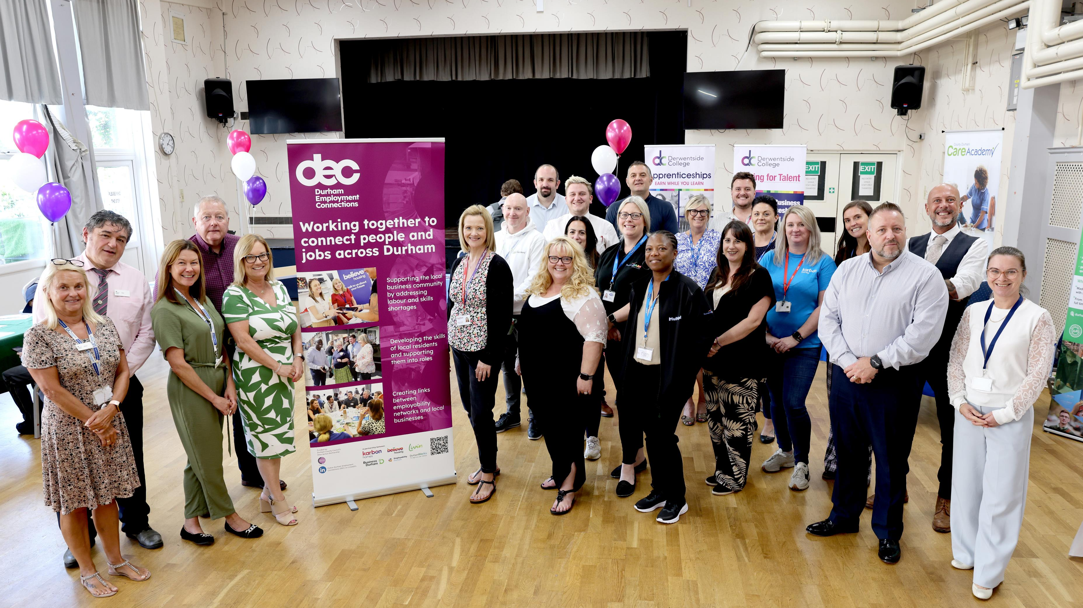

Welcome

Slide 3

1. | Refreshments & Registration | 08.30-0900
2. | Networking | 09.00-09.30
3. | Welcome & Introductions Moving Forward | 09.30-09.45
4. | Barclays- Melanie Tweddle | 09.45-10.15
5. | All Age Careers Framework- Dr Deidre Hughes | 10.15- 11.00
6. | Break | 11.00-11.15
7. | NECA- Lucy Johnson | 11.15-11.45
8. | Questions & AOB | 11.45-12.00

Slide 4
Barclays
Melanie Tweddle

Slide 5
All Age Careers Framework
Dr Deirdre Hughes

Slide 6
Time for a Break

Slide 7
North East Ambition update
Lucy Johnson
15-11-2024
Durham Employment Forum

Slide 8
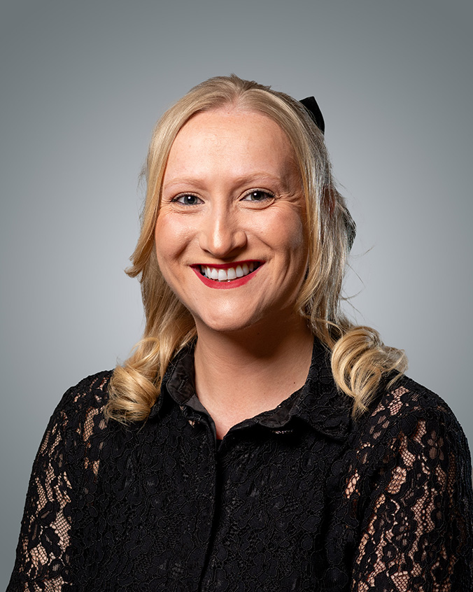
Welcome and introductions
Lucy Johnson
Careers Facilitator
Skills for Business

Slide 9
Background and context

Slide 10
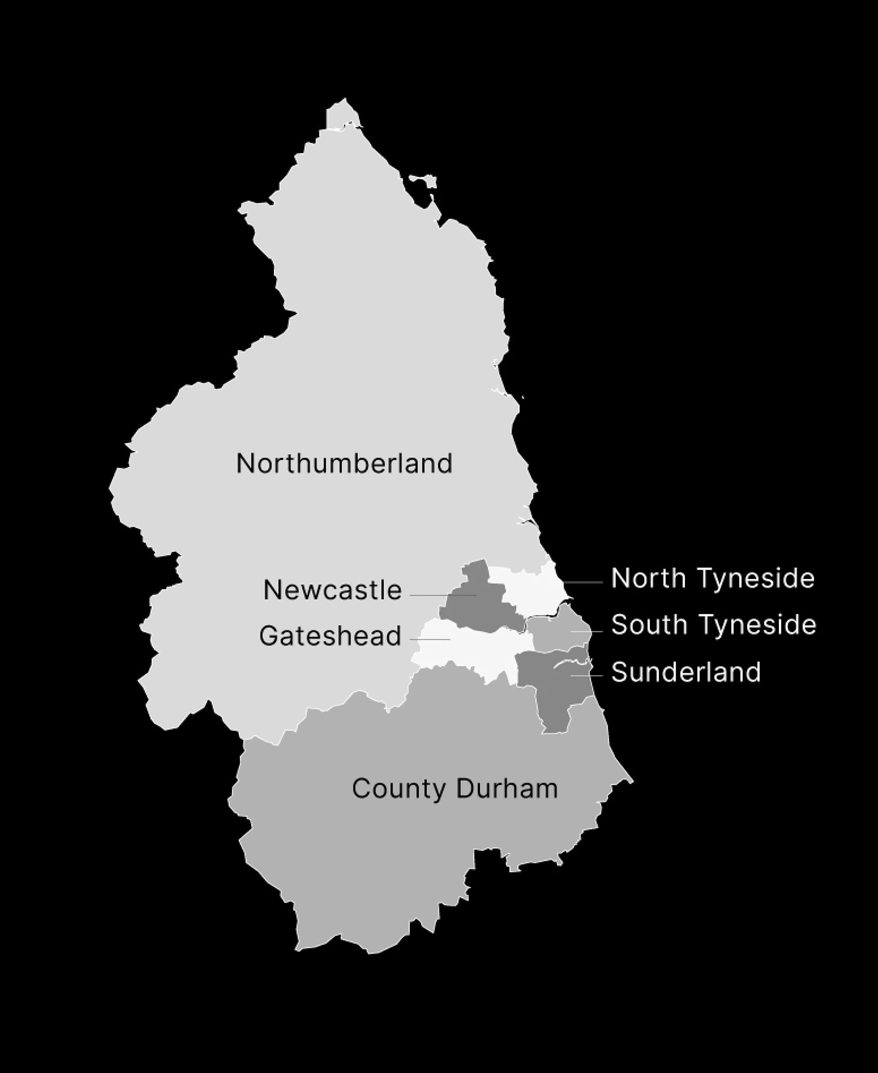
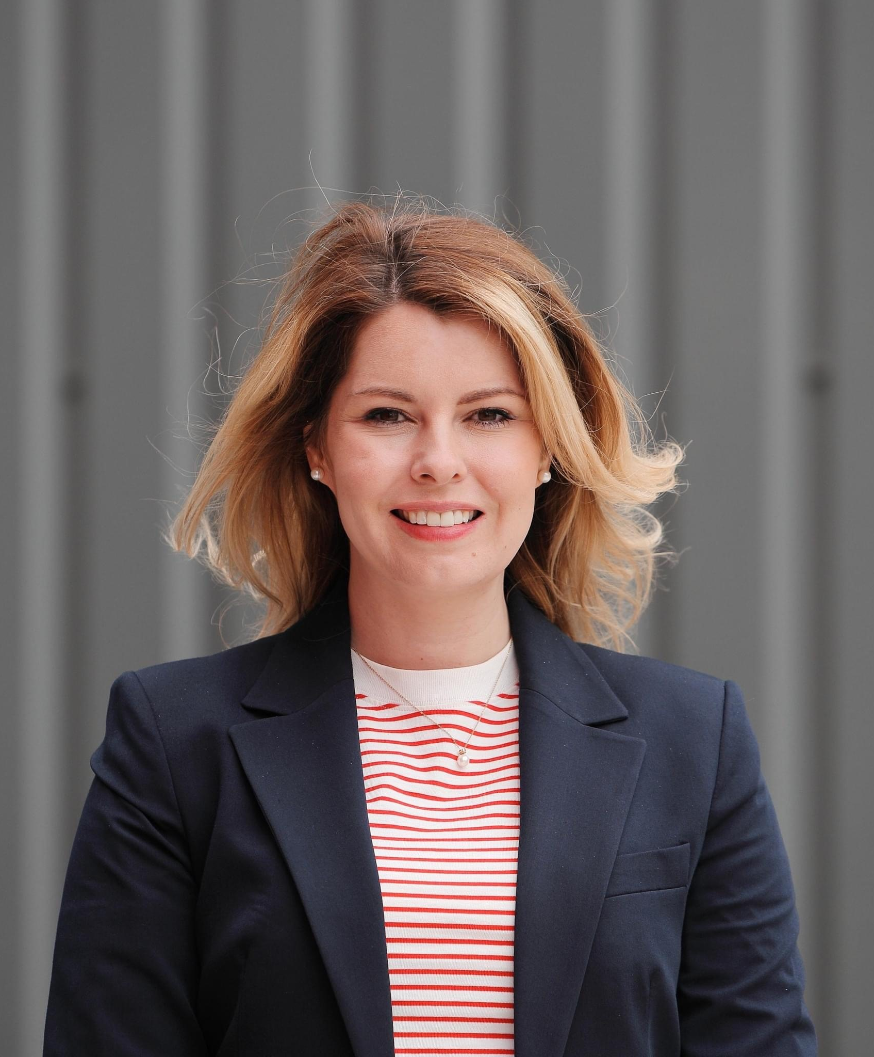
Our North East Vision
Our purpose is to champion the full potential of our region.
Collaborating with our partners and local authorities, we’ll create a better way of life by connecting communities, giving people the skills to succeed, and improving wellbeing for all, so that the North East is recognised as an outstanding place to live, work, visit and invest.
Notes:
Firstly, as I’m sure many of you are aware, the North East Combined Authority came into being on the 7th May following the appointment of Kim McGuinness as the new Mayor of the region. The North East LEP, with four other organisations are now recognised as the North East Combined Authority

Slide 11
Interim Portfolios
Transport
Finance and Investment
Rural, Coastal and Environment
Culture, Creative, Tourism and Sport
Economy
Housing and Land
Education, Skills and Inclusion
Strong collaboration across portfolios… with net zero, digital, public sector reform & addressing health inequalities as cross-cutting

Slide 12
Education, Skills & Inclusion
Skills for Business (North East Ambition)
Strategic objectives:
Improve the quality of good careers education and guidance through Career Hubs
Increase meaningful employer engagement across schools and colleges
Ensure curriculum represents labour market need and prepares our future and current workforce
Stimulate learner and employer demand for apprenticeships
Increase access to meaningful work experience and T level industry placements
Provide access to short term opportunities for adults to reskill, upskill and gain new skilled opportunities

Slide 13
National/Regional Update:
There is a lot of change taking place currently in 'careers' - locally/nationally:
Ofsted Thematic Review
Sir John Holman’s Recommendations
Education Select Committee Report
Gatsby Foundation: Next 10 Years Review
General Election
North East Combined Authority
National systems e.g. Careers Impact System
‘Churn’ of Career Leaders
However, as a region, we are in a good place!

Slide 14
Setting the Scene
North East Ambition

Slide 15
Background
North East Ambition has been in delivery since 2017*
It is focused on supporting schools and colleges to deliver high quality careers education and bridging the gap between employers and education
It includes the North East Careers Hub – continuing contract delivered on behalf of DfE since 2018
The North East Careers Hub involves 182 schools and colleges (KS3+) and intends to reach full coverage (192) by end of 2024-25
We have also had a Primary programme (approx. 300 schools) since 2019, which currently includes delivering a DfE contract

Slide 16
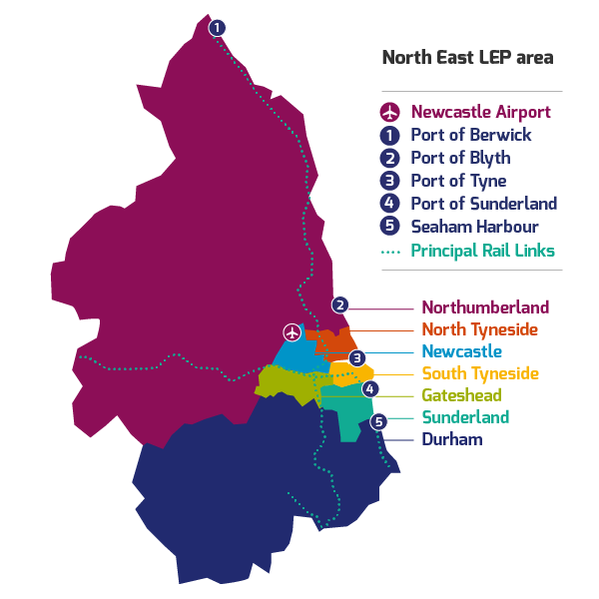
Our network
Region
300 Primary Schools
179 Secondary* and Special Schools
9 FE Colleges
Durham
48 Secondary including Special Schools
69 Primary Schools
            * includes middle schools
Notes:
Images
Unsplash
References
https://www.northeastlep.co.uk/key-sectors/digital/
https://www.northeastlep.co.uk/key-sectors/advanced-manufacturing/
https://www.northeastlep.co.uk/key-sectors/energy/

Slide 17
Aims and objectives
North East Ambition aims to:
Raise the quality of careers education in the North East – with a focus on leadership and training
Provide more high quality experiences with employers – for young people and teachers
Amplify apprenticeships and technical education
Connect careers provision and the local economy
Target interventions on economically disadvantaged young people and those who face other barriers
Through this work we will:
Improve social mobility and create an inclusive economy
Reduce educational disadvantage and improve life chances
Reduce the disconnect between aspirations and LMI
Improve employability and productivity and help drive economic growth
Improve destination figures and reduce NEET figures

Slide 18
What does the data tell us?

Slide 19
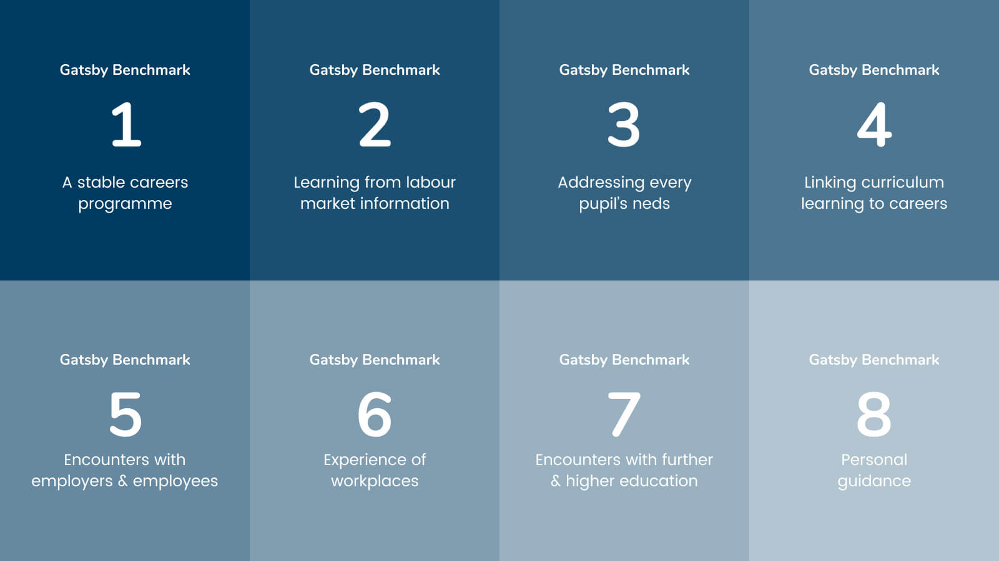

Slide 20
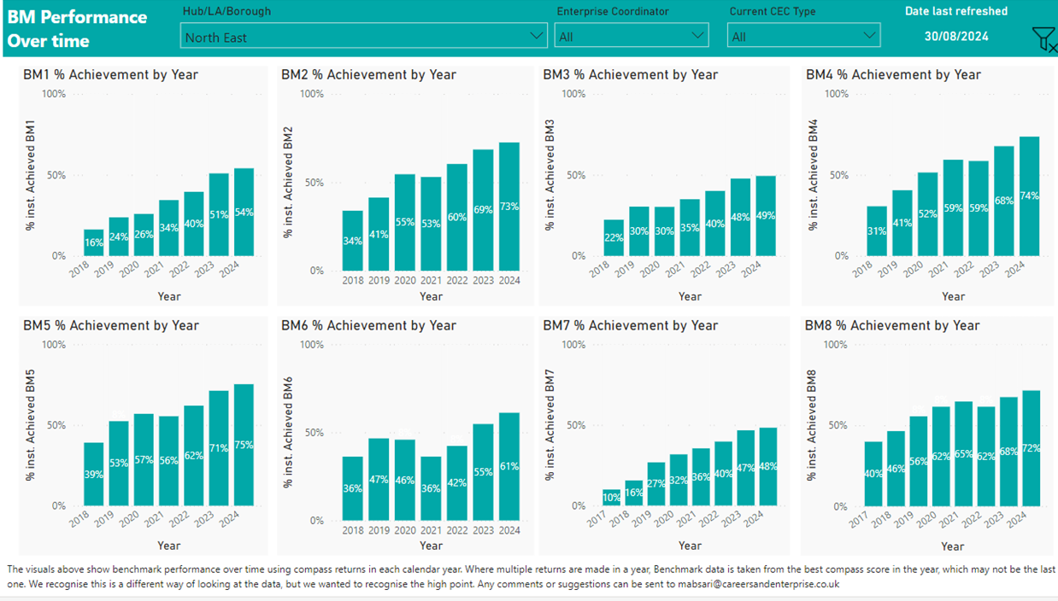
Progress

Slide 21
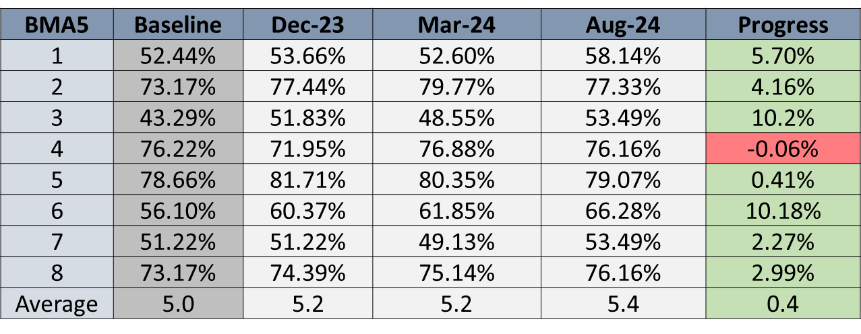
Progress
BM | Baseline | Dec-23 | Mar-24 | Aug-24 | Progress
1 | 52.44% | 53.66% | 52.60% | 58.14% | 5.70%
2 | 73.17% | 77.44% | 79.77% | 77.33% | 4.16%
3 | 43.29% | 51.83% | 48.55% | 53.49% | 10.2%
4 | 76.22% | 71.95% | 76.88% | 76.16% | -0.06%
5 | 78.66% | 81.71% | 80.35% | 79.07% | 0.41%
6 | 56.10% | 60.37% | 61.85% | 66.28% | 10.18%
7 | 51.22% | 51.22% | 49.13% | 53.49% | 2.27%
8 | 73.17% | 74.39% | 75.14% | 76.16% | 2.99%
Average | 5.0 | 5.2 | 5.2 | 5.4 | 0.4

Slide 22
Durham
 | Average BM | BM1 | BM5 | BM6
National | 5.8 | 69.2% | 85% | 72.1%
Region | 5.4 | 58.2% | 80% | 65.9%
Durham | 5.5 | 71% | 58.6% | 72.6%
Region (SEND) | 5.1 | 37.9% | 79.3% | 62.1%
Durham (SEND) | 5.3 | 65% | 83.2% | 83.3%

Slide 23
2023-24
Regional average BM: 5.4 (+0.4)
Good progress in most individual BMs
Significant progress in BM3 and BM6
Faster progress for special schools (SEND) & the most disadvantaged schools FSM (Q4)
Increase of 12% of schools and colleges achieving all 8 BMs
Reduction in no. of schools and colleges below 3 BMs

Slide 24
SEND insight

Slide 25
History
2015-2017 – Gatsby Pilot (testing Benchmarks)
2017 – DfE Careers Strategy (adopting Benchmarks)
2018 – Career Hubs established (including in NE)
2019 – SEND Hub established in NE
2022 – SEND Hub incorporated into NE Careers Hub

Slide 26
SEND Hub (2019-2023)
Mapped all the SEND institutions in the North East region
Brought SEND institutions together – Community of Practice
Supported individual Career Leaders and SEND institutions
Produced regular bulletins
Developed SEND resources e.g. LMI
Supported employer engagement including through Enterprise Adviser Network

Slide 27
SEND - 2023/24
Continued 1:1 support and broader support (CoP) - targeted at 0-2 schools
Increased focus on AP/PRU/SEMH
Focussed projects including Effective Transition Fund (including SEND in mainstream)
Interest in transition
Increased focus on supporting employer engagement including providing experiences of the workplace (e.g. Alnwick Gardens)
Engagement with wider SEND community (SEND conference)
New resources: LinkUp Portal
Other projects: Early Connect

Slide 28
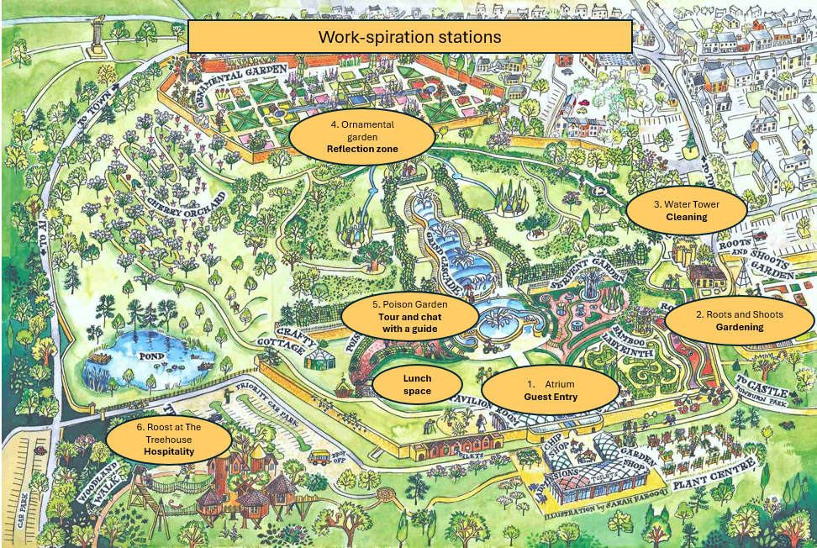
Alnwick Gardens
Skills Day
3 local Special Schools in Northumberland
36 students gaining hands on experience to explore five different job roles at the gardens gaining an insight into career opportunities and skills required.
Aim to provide real world experiences of the workplace for students with additional needs.

Slide 29
Next steps in 2024-25
Continued 1:1 support
Skills Day – Beamish Museum experiences of the workplace
Enhanced community of practice offer including SEND conference
CPD/Training offer for careers leaders and careers advisors
Developing projects for young people at risk at falling through the net e.g. home educated
Developing resources e.g. Buzz

Slide 30
Useful links
Website and resources:
Homepage - North East Ambition
SEND schools - North East Ambition
SEND Toolkit - North East Ambition
Employers:
Business - North East Ambition
LinkUp Portal - North East Combined Authority

Slide 31
Get in touch
Lucy Johnson –Lucy.Johnson@northeast-ca.gov.uk
SEND Hub lead – Peter.Hunter@northeast-ca.gov.uk

Slide 32
Thank You!

Slide 33
Questions?

Slide 34
Next Forum
17th January 2025
https://www.eventbrite.co.uk/e/848489203047?aff=oddtdtcreator

Slide 35
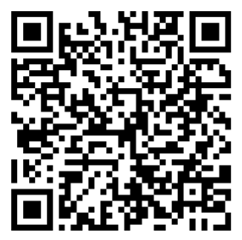

Thank you
Scan to view LinkedIn page:

