Slide 1


Foundations for Life
Karbon Homes
Brendan McCreesh
Employment Advisor
Durham

Slide 2
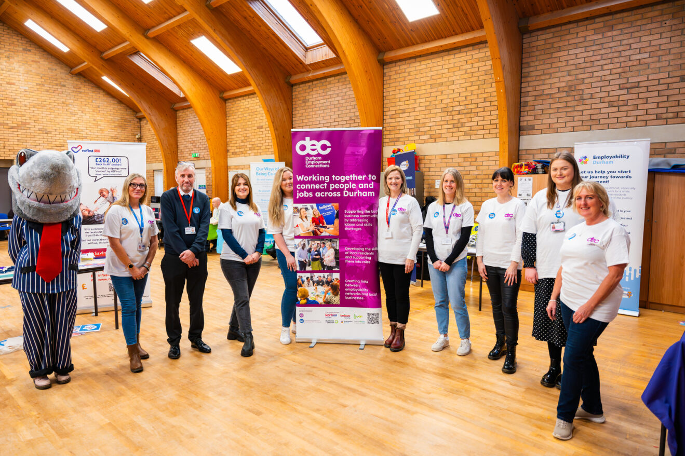
Pathways to Employment Event
Chester-Le-Street
Friday 20th October 2023 @ Parish Centre

Slide 3
SWOT – Event discussions: What is needed, what to avoid
Initial Planning, Ideas & Local Labour Market Research
Agree Aims & Objectives
Involve Service Users
Event Promotion
Our Journey…

Slide 4
Agreed Aims and Objectives
Focus on neurodivergent groups and wanted to make it an event that was as inclusive as possible
Small and targeted
Add value / rewards for people attending e.g.., complete part of an application process, enrol onto a course, have some support activities put in place
People to be opened up to the fact that ‘employment’ is a journey – and people are on different points of that journey (and an event to support this) and support services to reflect this
We want those with lived experience to be part of the event planning and the event

Slide 5
Attendees – Disability Confident Organisations
Mr Kevin Jones MP
Councillor Scurfield
Avon
Catch 22
Care Academy
Credit Union NE
Co-op
Durham Community Action
DCC Recruitment
Durham Employability
Durham Enable
Durham Learn
Durham Police
Durham University
Durham Works
DWP
Groundwork
Mental Health Matters
REED
Stamp it Out
Zenith
Karbon Homes

Slide 6
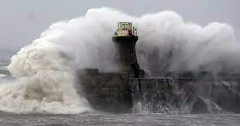
Best Laid Plans…
Storm Babet
Bus Strikes
The perfect day for an event…

Slide 7
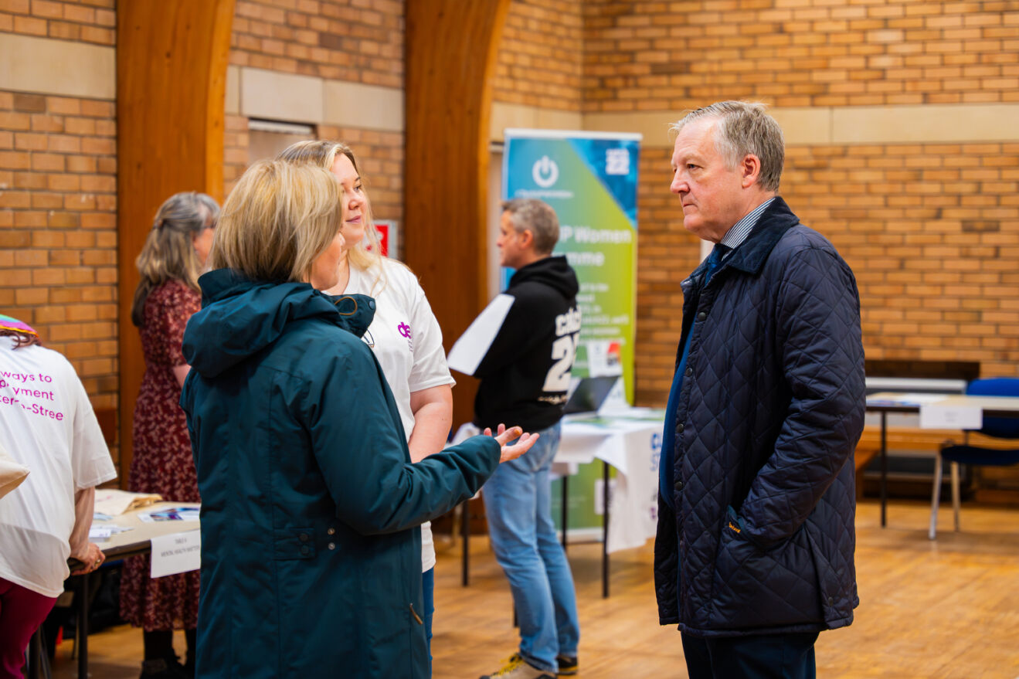
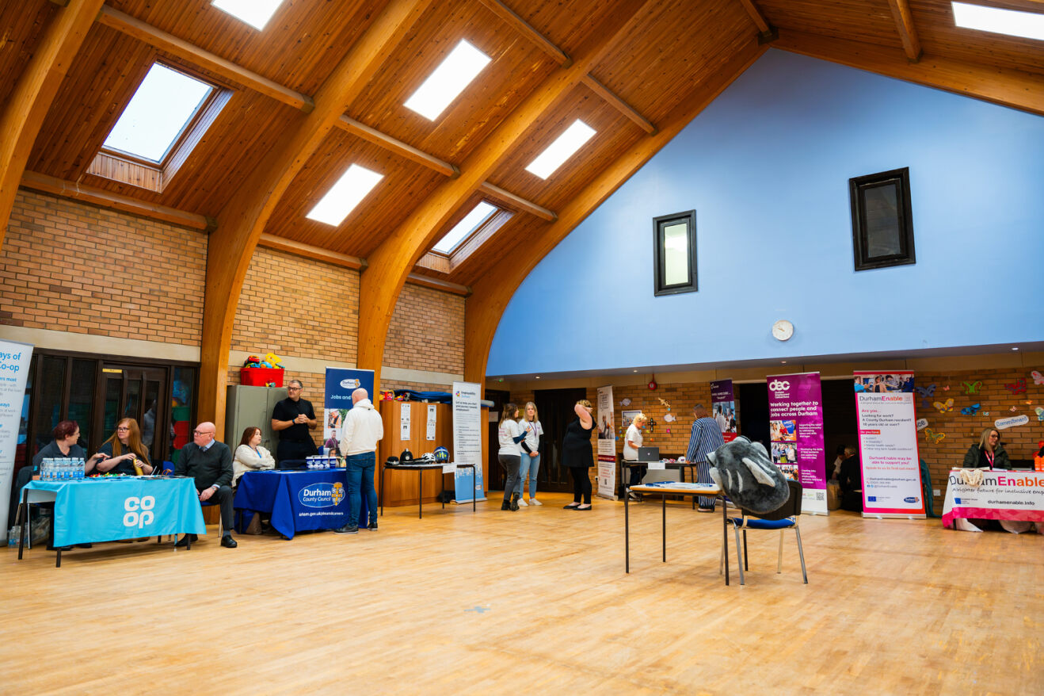
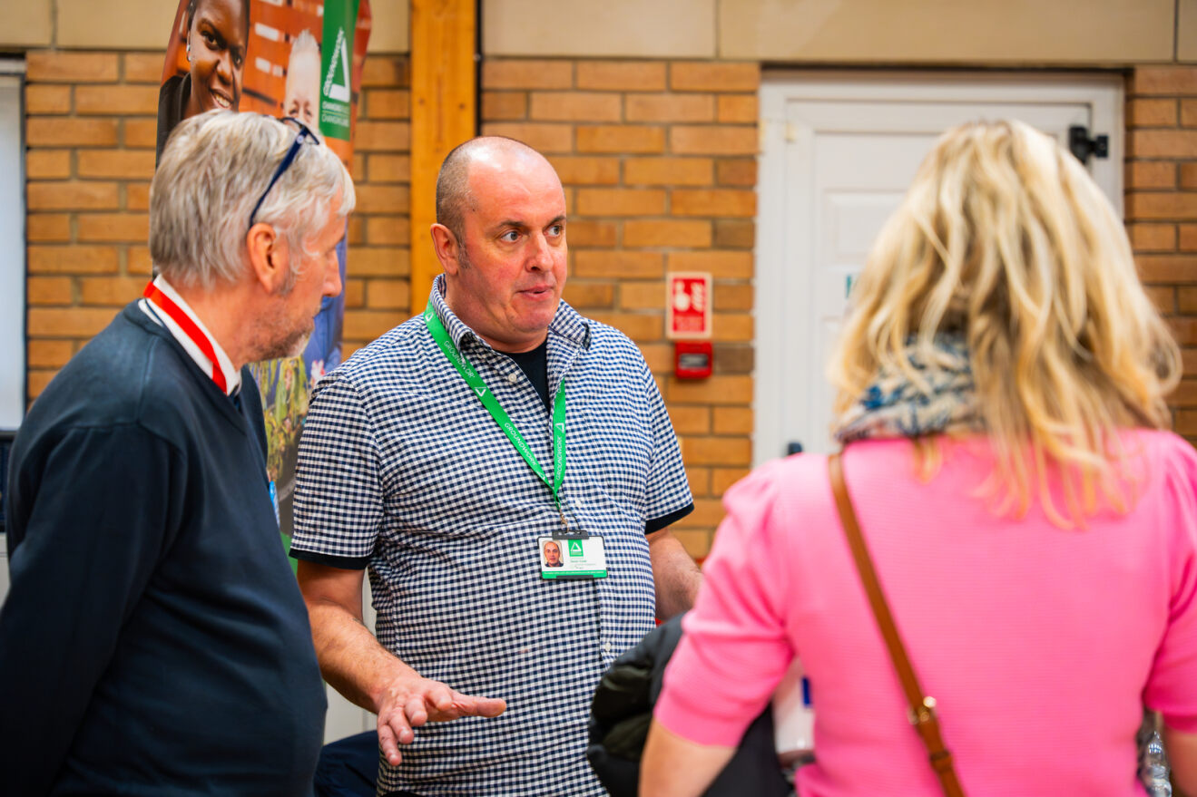
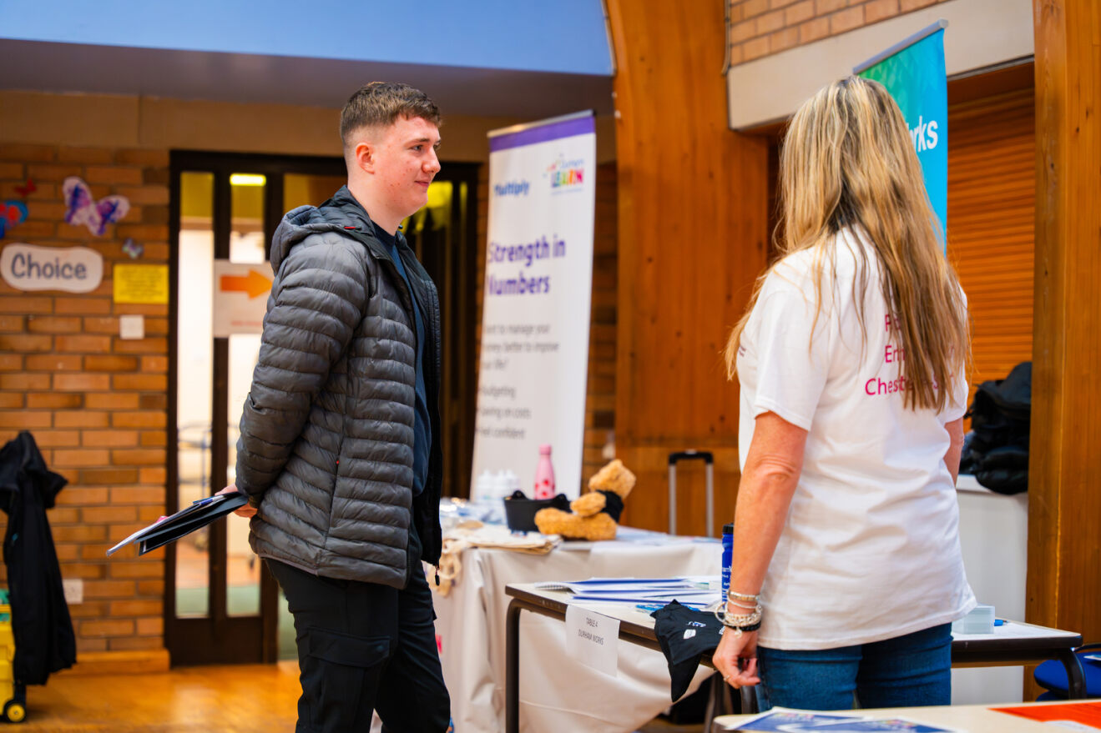
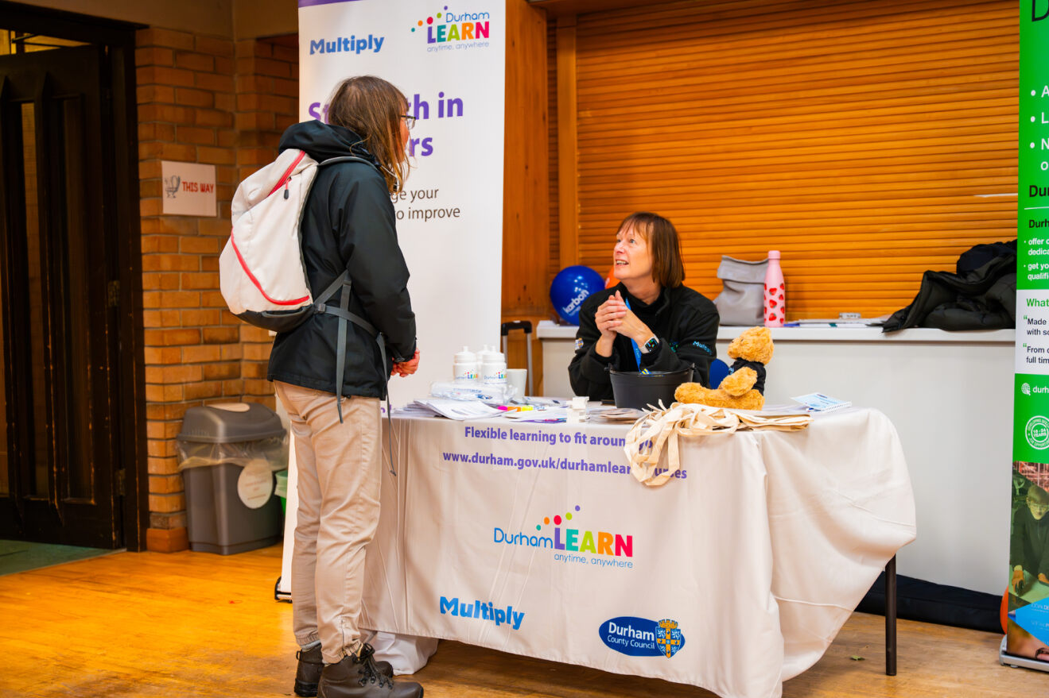
Our Event

Slide 8
How many businesses attended? 20 attended – split between recruiting employers , training providers , support services
How many members of the public attended? 14
We had service users volunteer on the day to help steward and support the event
Location and venue ideal for size
Venue also had informal and private rooms for sensitive discussions / Socially anxious people
Attendees were supported throughout the day
MP and Local Councillor attended bringing awareness to the businesses and their great work
Collaboration of the Sub-Group AND external Stakeholders

Slide 9
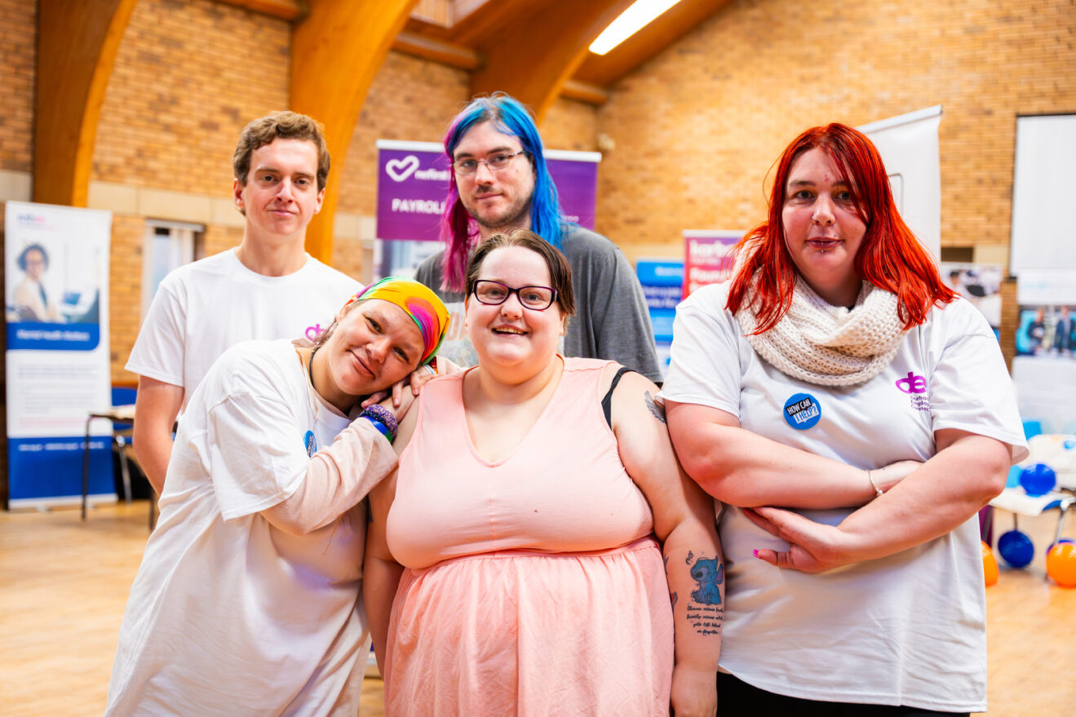
The A Team

Slide 10
Event Feedback: Direct Quotes
Why did you volunteer to be part of the event? Because I believe in giving people a chance to get on their feet; Because the idea of the event intrigued me and I was curious to learn more about recruitment processes.
What did you enjoy most about the event? I enjoyed getting to meet new people and promoting different groups to guests; I enjoyed the group of people that I got to work with the most and Excellent teamwork involved all around.
What kind of Skills / Experience have you gained from the event? I have learned how to help people with different needs; I have learned how to organise and plan an event and I was able to regain some insight regarding a busy, structured working day.
Would you like to be part of future events? I would love to be part of future events to help people as I eventually want to become a support worker and without question, I would definitely be interested in taking part in a day like that again!
"It was awesome"; "It was nIce that people spoke to me and made me feel welcome"; "I have had my best day for ages"; "Staff were lovely"; "I felt looked after and important".

Slide 11
Thank You, What Next and Close
Thank You
What Next
Close and Questions

Slide 12


Any questions?

